Slide 1
Measuring Acidity
Matthew Katterman

Slide 2
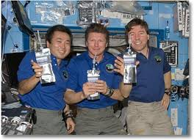
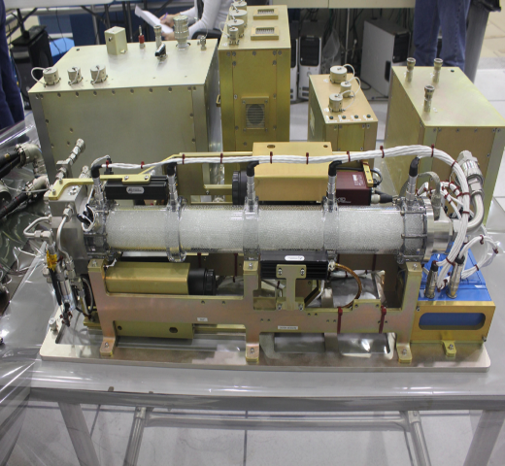
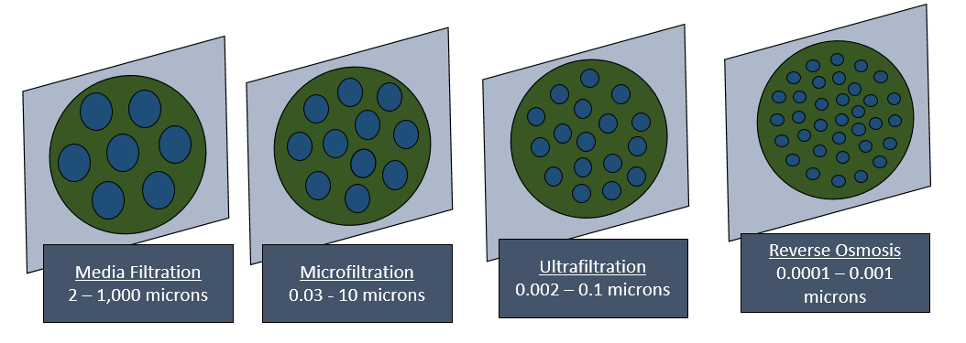
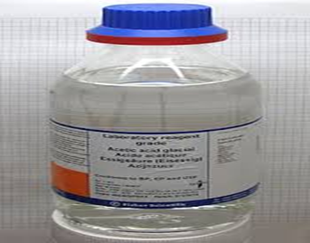
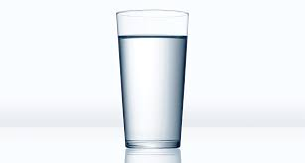
Clean water from filtration
One way Astronauts get clean water is from filtration
Many kinds of filtration, some are better than others
Not all contaminants or pollutants are removed from filtration sometimes
Some chemicals are left in the water afterwards. Many of them are colorless.

Slide 3
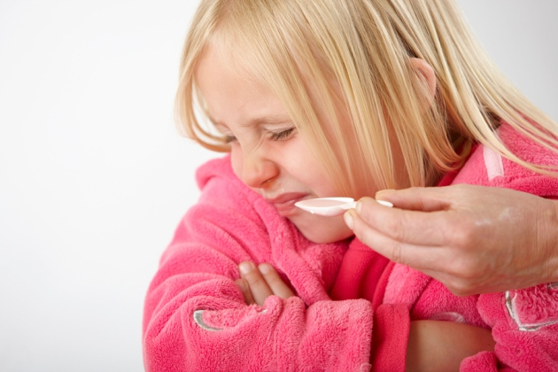

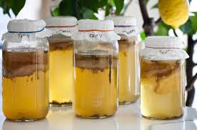
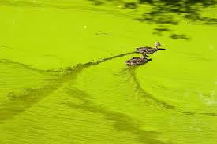
Examples of Acidity and Basicity
Chemicals in water make it more Acidic or Basic.
Why is this important?
This affects the way the water tastes or how healthy the water is for you.
Bacteria or algae can grow in water with chemicals in it.
Bacteria grow with organics in it. The water is slightly acidic.
Algae grows with fertilizer chemicals in it. This makes it slightly basic

Slide 4
What are Acids & Bases?
ACID - a chemical that gives off hydrogen ions in water. A molecule that can donate a proton. Acidity is measured on a scale called the pH scale
BASE - a chemical species that donates electrons or releases hydroxide (OH-) ions in aqueous solution. Basicity is also measured using the pH scale
WATER
ACID
CHEMICAL
Hydroxide Ion (OH-)

Slide 5
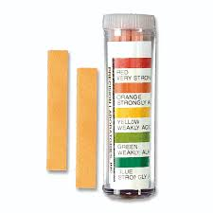

Measuring Acidity or Basicity
How can we tell if water is acidic or basic?
We can use pH paper that changes color.
Is on a scale from 1 – 14 usually
1 – 6 is Acidic, 8 – 14 is Basic
There are colors for each of the pH numbers.
It is preferable that water be neutral (pH = 7)
May be ok if not too far from pH 7 (5 – 9)
Acetogenic Bacteria = pH 4-5
Blue-green algae = pH 9-10

